Slide 1
Data Mining
Chapter 3
Data warehousing (OLAP)

Slide 2
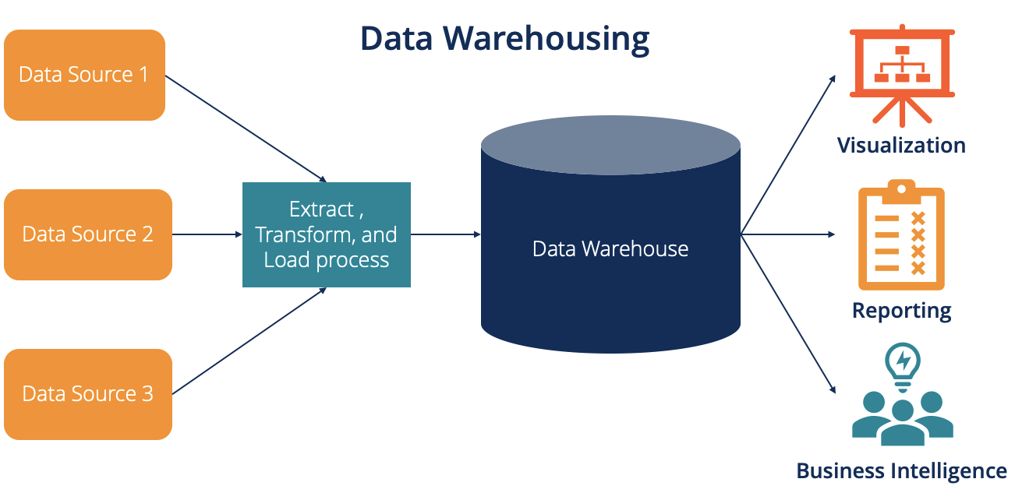
Data warehouses: Definition
DWs are central repositories of integrated data from one or more disparate sources.
They store current and historical data in one single place that are used for creating analytical reports for workers throughout the enterprise.

Slide 3
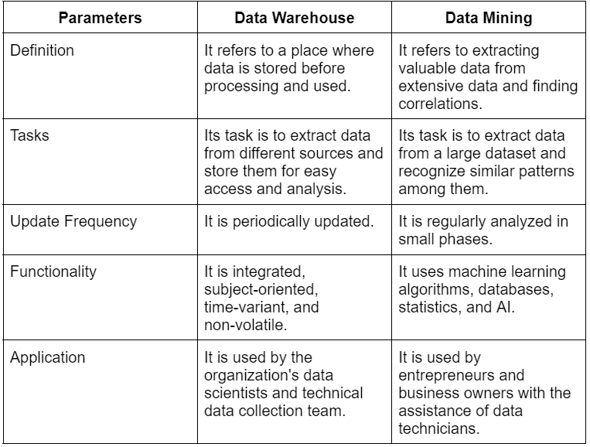
Data warehouse vs data mining

Slide 4
Data Integration and the Extraction, Transformation, and Load Process

Slide 5
Characteristics of DWs
Subject oriented
Data are organized by detailed subject, such as sales, products, or customers, containing only information relevant for decision support.
Integrated
Integration is closely related to subject orientation. Data warehouses must place data from different sources into a consistent format
Time-variant (time series)
A warehouse maintains historical data. The data do not necessarily provide current status (except in real-time systems). They detect trends, deviations, and long-term relationships for forecasting and comparisons, leading to decision making

Slide 6
Characteristics of DWs
Nonvolatile
After data are entered into a data warehouse, users cannot change or update the data. Obsolete data are discarded, and changes are recorded as new data.
Summarized
Not normalized
Metadata
are data about data. Metadata describe the structure of and some meaning about data

Slide 7
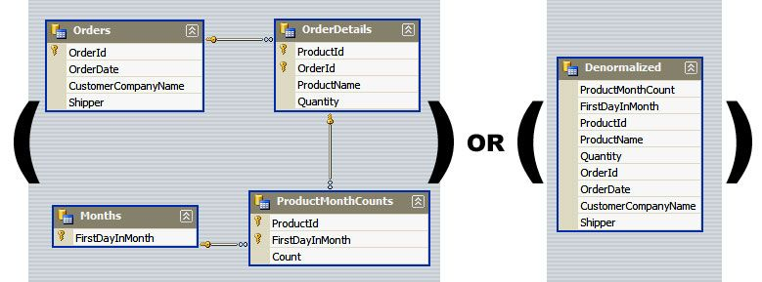
Not normalized

Slide 8
Characteristics of DWs
Web based
Data warehouses are typically designed to provide an efficient computing environment for Web-based applications.
relational/multi-dimensional
A data warehouse uses either a relational structure or a multidimensional structure.
Client/server, real-time/right-time/active...

Slide 9
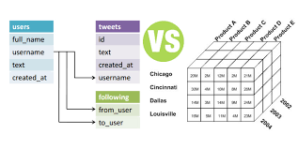
relational/multi-dimensional

Slide 10
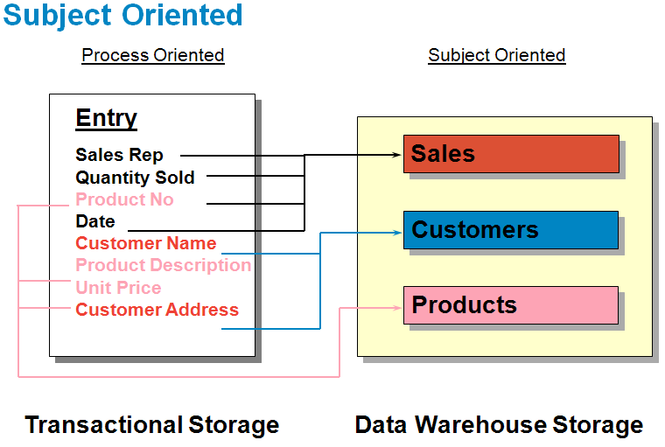

Slide 11
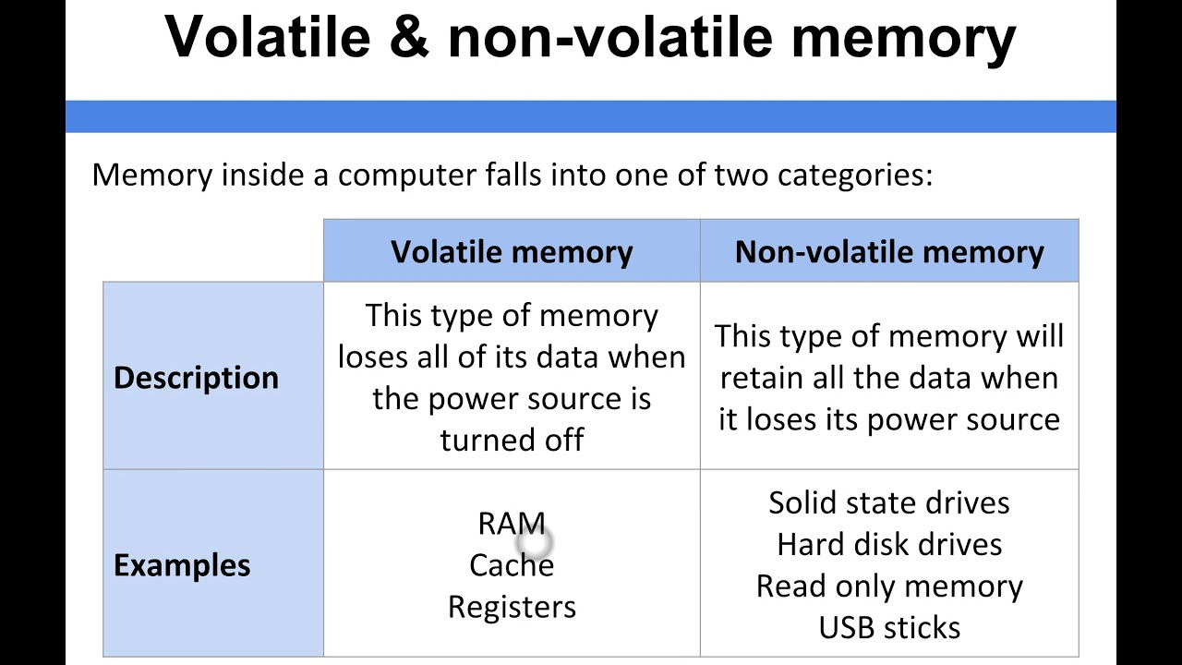

Slide 12
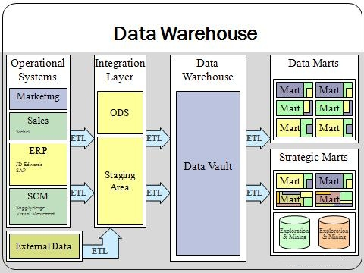

Slide 13
Data Mart
A departmental small-scale “DW” that stores only limited/relevant data
Dependent data mart
A subset that is created directly from a data warehouse
Independent data mart
A small data warehouse designed for a strategic business unit or a department

Slide 14
A Generic DW Framework

Slide 15
Representation of Data in DW
Data Representation refers to the form in which data is stored, processed, and transmitted
Dimensional Modeling
A retrieval-based system that supports high-volume query access
Star schema
The most commonly used and the simplest style of dimensional modeling
Contain a fact table surrounded by and connected to several dimension tables
Snowflakes schema
An extension of star schema where the diagram resembles a snowflake in shape

Slide 16
Star versus Snowflake Schema

Slide 17
Multidimensionality
The ability to organize, present, and analyze data by several dimensions, such as sales by region, by product, by salesperson, and by time (four dimensions)
Multidimensional presentation
Dimensions: products, salespeople, market segments, business units, geographical locations, distribution channels, country, or industry
Measures: money, sales volume, head count, inventory profit, actual versus forecast
Time: daily, weekly, monthly, quarterly, or yearly

Slide 18
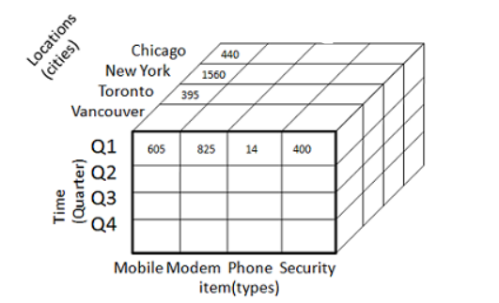
Warehouse cube

Slide 19
OLAP basic operations
Roll up: The roll-up operation (also known as drill-up or aggregation operation) performs aggregation on a data cube (zoom-out).
Drill down: The drill-down operation (also called roll-down) is the reverse operation of roll-up. Drill-down is like zooming-in on the data cube. It navigates from less detailed record to more detailed data.
Slice: A slice is a subset of the cubes corresponding to a single value for one or more members of the dimension.
Dice: he dice operation describes a subcube by operating a selection on two or more dimension.

Slide 20
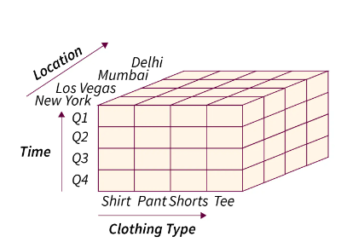
OLAP operations with an example
Assume that we have our data structured as a cube (3-dimensions)

Slide 21
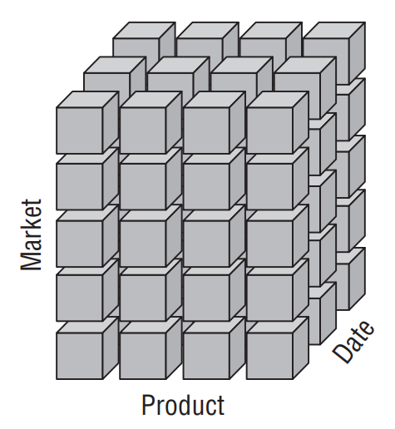
Online analytical processing (OLAP)
OLAP is a software technology that allows users to analyze information from multiple database systems at the same time

Slide 22
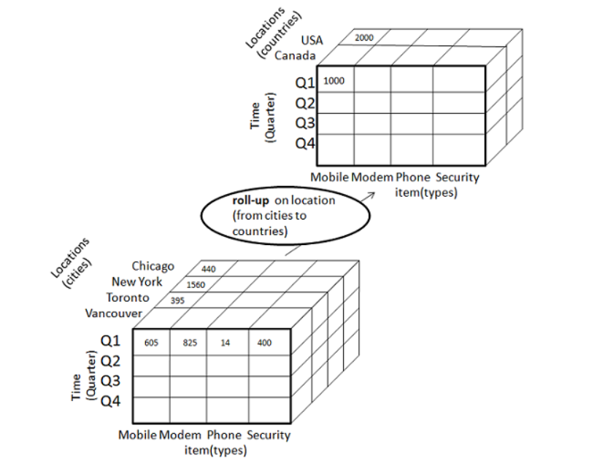
Roll-up

Slide 23
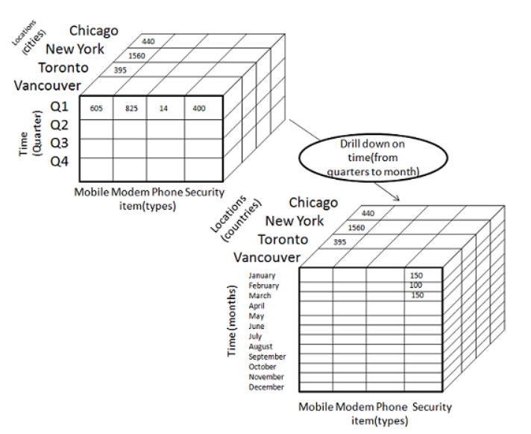
Drill-down

Slide 24
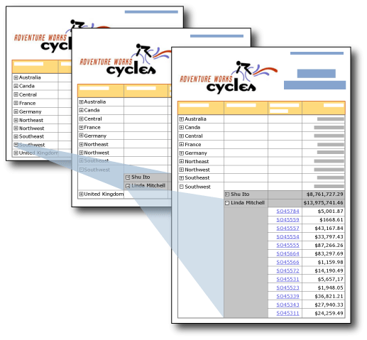

Slide 25
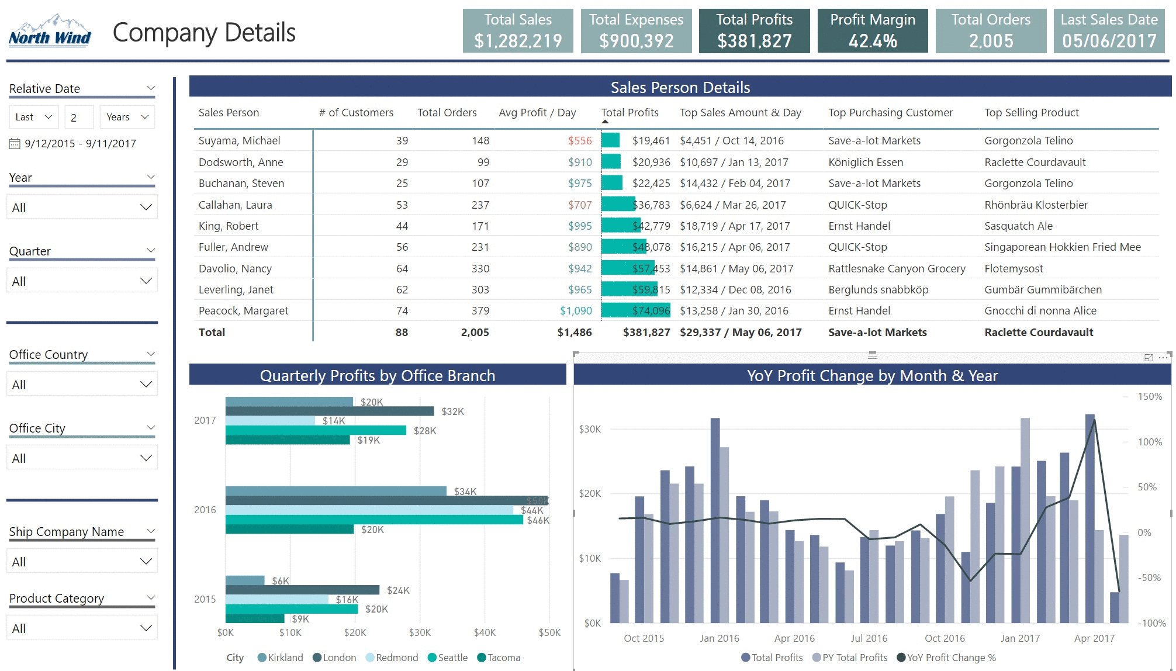

Slide 26
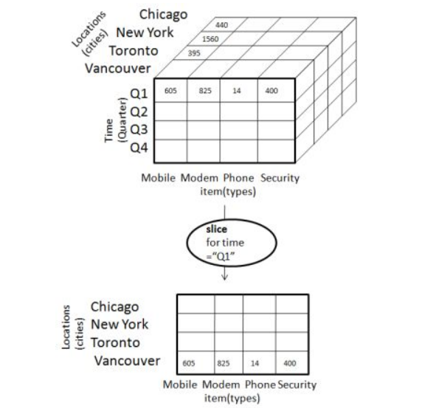
Slice

Slide 27
OLAP
Slicing Operations on a Simple Tree-Dimensional
Data Cube

Slide 28
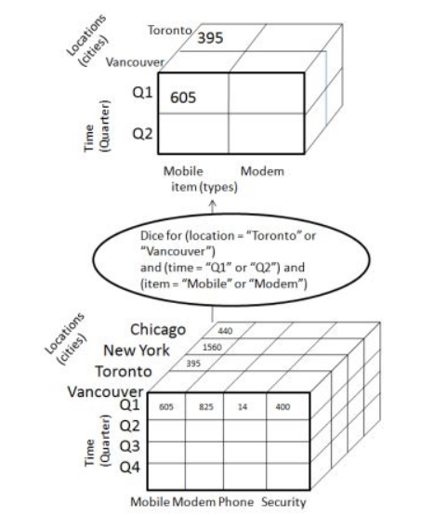
Dice

Slide 29
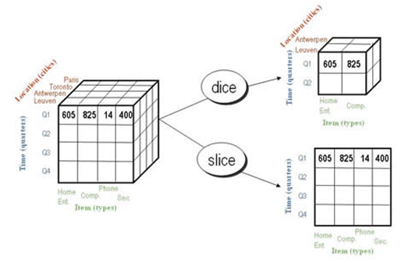

Slide 30
Data mining challenges
Scalability
Dimensionality
Complex and Heterogeneous Data
Data Quality
Data Ownership and Distribution
Privacy Preservation
Streaming Data

Slide 31
Scalability
The real world is massive and so the data in it.
We usually train and test on a relatively small data compared to what is there is real-life.
We could say that our model is perfect when we get a high performance. BUT is this generalized to real world data OR much bigger data?
it should be. but it is hard to say
Extracting information from data requires huge computational power which is not always available.

Slide 32
Dimensionality
High dimensional data is hard to work on and extract patterns from.
With high dimensional data we need the volume of the data to be very large to be able to extract knowledge from it.
Data is not always available in real life or not easy to collect

Slide 33
Complex and Heterogeneous Data
Data come from various resources.
There is no single way to handle the data as each data type need a unique method(s) to handle
Example of data sources might include:
Images
Videos
Audio
time series
Tabular data (which might come from surveys)
JSON / XML
Raw text

Slide 34

Data Quality
Collecting real-life data often results in various problems which affect the quality of the data.
The data collected by sensors usually contain various outliers, noise, missing data (or mix of these problems)
Images, for examples, can be affected by illumination, detorsion, blurring and many more problems

Slide 35
Data Ownership and Distribution
Data is not available in one place, and it takes time to aggregate and collect
In addition, there are strict rules govern the access
The data available for experimenting/training/extracting knowledge is often small (depending upon the problem)
Example: Many patients are not willing to share their medical records.

Slide 36
Streaming Data
In the recent world data flows continually from different sources.
Which means the data needs real-time processing
Processing data streams requires massive computational power.
Some recent effort to improve the ability of processing data streams:
Using clusters, parallel computing (Apache Spark)

